Slide 1
Cutnell & Johnson
Physics
Twelfth Edition
David Young and Shane Stadler
CHAPTER 8
Rotational Kinematics

Slide 2
8.1 Rotational Motion and Angular Displacement (1 of 9)
Learning Objective 8.1 – Define angular displacement.
So far, we've focused on the motion of objects as they move from one place to another—along a straight line (Chapter 02), through two dimensions (Chapter 03), or even around a circle at constant speed (Chapter 05).
Now we'll shift our attention from where an object moves to how an object itself rotates.
We will begin by introducing a new set of variables that describe
rotational motion
.
By using angular displacement, angular velocity, and angular acceleration, we'll build a rotational version of
kinematics
that will look quite familiar to you.

Slide 3
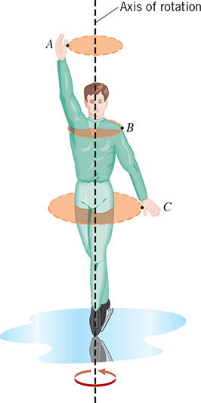
8.1 Rotational Motion and Angular Displacement (2 of 9)
Imagine a rotating object, such as a spinning figure skater, for example.
Each point on the object (e.g. A, B, and C) will sweep out a
as the object rotates.
circular path
The centers of these circular paths will lie along a common line known as the
.
axis of rotation
We could ask the following question: During a certain time, through what angle does each point rotate?

Slide 4
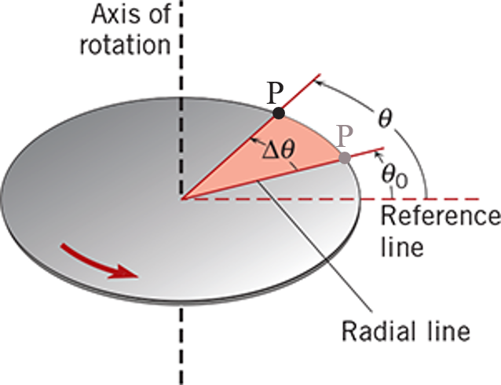
8.1 Rotational Motion and Angular Displacement (3 of 9)
To help us answer this question, let’s consider a solid disc rotating about an axis through its center, as shown in the figure.
Point P on the edge of the disc begins at some initial angle, θ₀, relative to a reference line, and maybe the reference line corresponds to 0 rad, for example.
After some time interval, Point P rotates to its final angle, θ, relative to the reference line, and during this time, Point P is displaced along the edge of the disc and sweeps out an angle
Δθ = θ − θ₀.
We refer to this motion of Point P as its
angular displacement
.

Slide 5
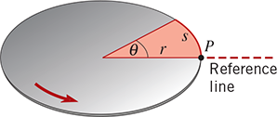
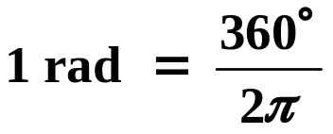

8.1 Rotational Motion and Angular Displacement (4 of 9)
DEFINITION OF ANGULAR DISPLACEMENT
When a rigid body rotates about a fixed axis, the angular displacement is the angle Δθ swept out by a line passing through any point on the body and intersecting the axis of rotation perpendicularly. By convention, the angular displacement is positive if it is counterclockwise and negative if it is clockwise.
*Note: Angular displacement is a vector quantity. We will see how to determine its direction in Section 8.7.
SI Unit of Angular Displacement: radian (rad)
When θ is measured in rad, the arc length distance, s, swept out along the edge of the disc is given by
s = rθ
.
(8.1)
It is also common to see θ measured in degrees.
Since one full revolution (rev) corresponds to both 2π rad and 360º, the following must be true:
1 rev = 2π rad = 360°
⇒

Slide 6
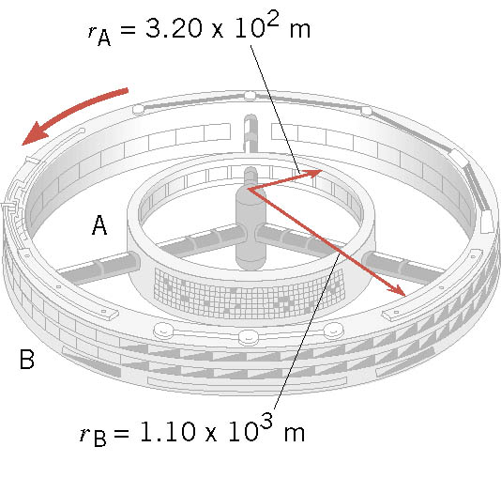
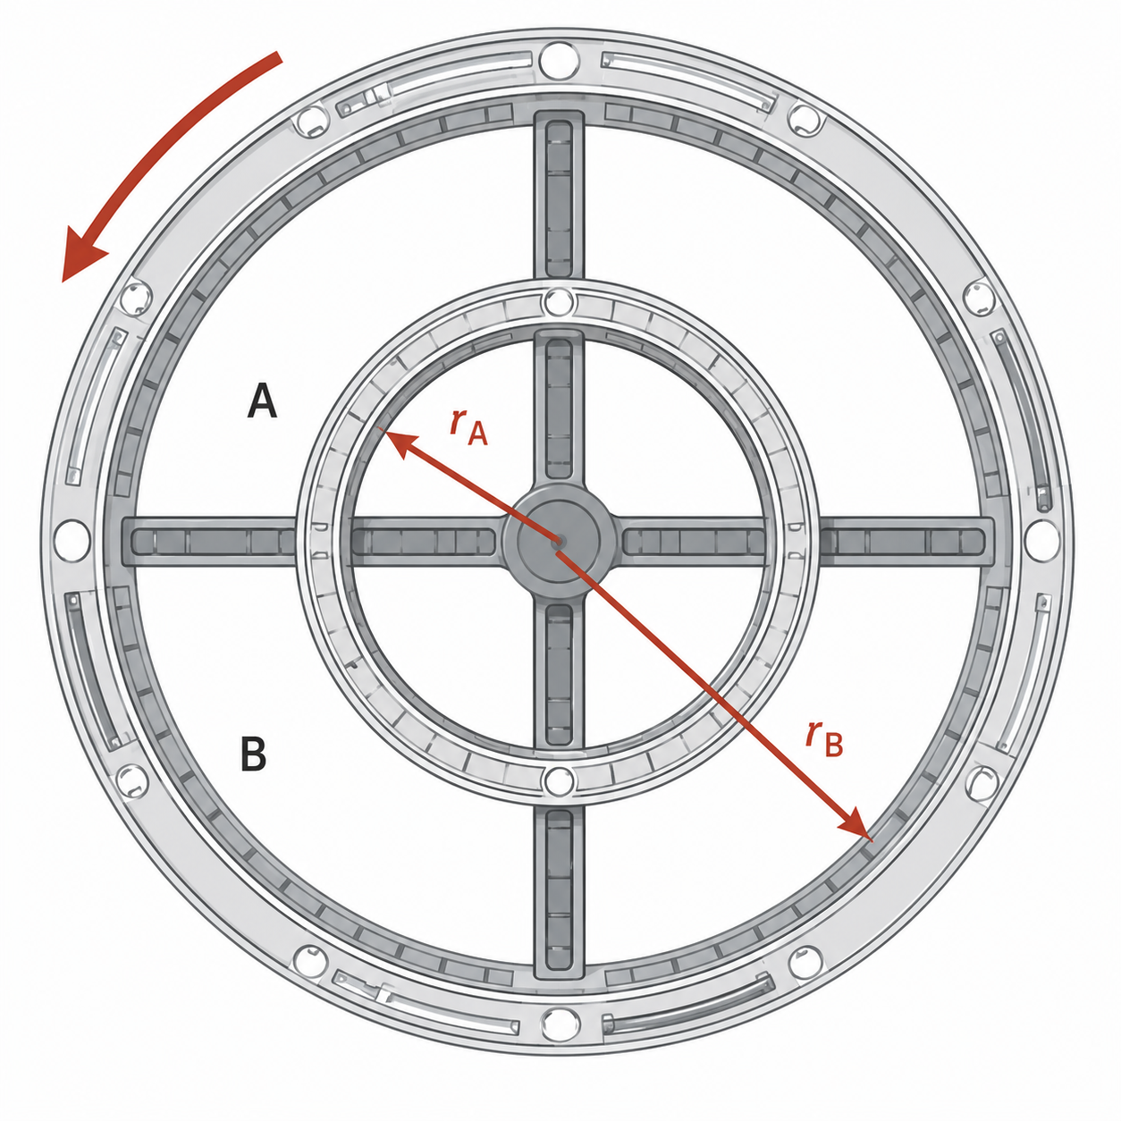
8.1 Rotational Motion and Angular Displacement (5 of 9)
Example – A Rotating Space Station
A space station consists of two donut-shaped living chambers, A and B, that have the radii shown in the figure. As the station rotates, an astronaut in chamber A is moved 2.40 × 10² m along a circular arc. How far along a circular arc is an astronaut in chamber B moved during the same time?
Let’s view the station from directly above.
Since the station is rigid, the chambers rotate together.
When rotated through some angle q, an astronaut in chamber A moves an arc length s_{A}, and an astronaut in chamber B moves an arc length s_{B}.
s_{A}
θ
s_{B}

Slide 7
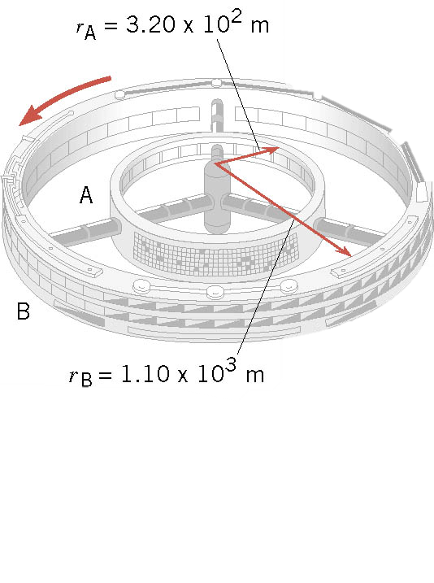
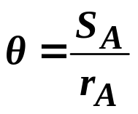
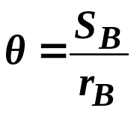
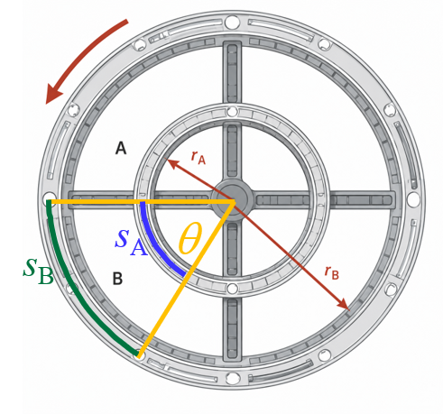
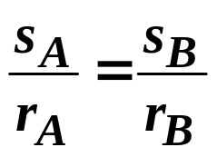
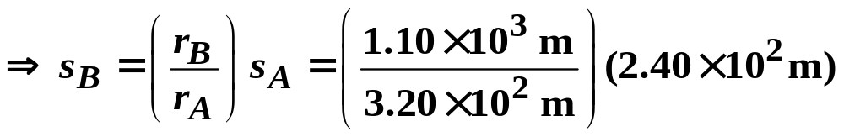
8.1 Rotational Motion and Angular Displacement (6 of 9)
Example – A Rotating Space Station
s_{A} = r_{A}θ
Here, we can apply Equation 8.1:
s_{B} = r_{B}θ
We stress again that the angular displacement (θ) of each astronaut is the same. Thus, from above:
and
We can now set these two equal to each other and solve for s_{B}:
While the astronaut’s angular displacements are equal, their linear displacements (arc lengths) are not. Astronaut B moves a greater distance because of the larger radius of chamber B.

Slide 8
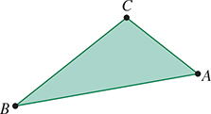
8.1 Rotational Motion and Angular Displacement (7 of 9)
CYU/TPS – In the figure, the flat triangular sheet ABC is lying in the plane of the paper. This sheet is going to rotate about first one axis and then another axis. Both of these axes lie in the plane of the paper and pass through point A. For each of the axes the points B and C will move on separate circular paths that have the same radii. Identify these two axes.
To satisfy these requirements, the perpendicular distance from points B and C to each axis must be equal!

Slide 9
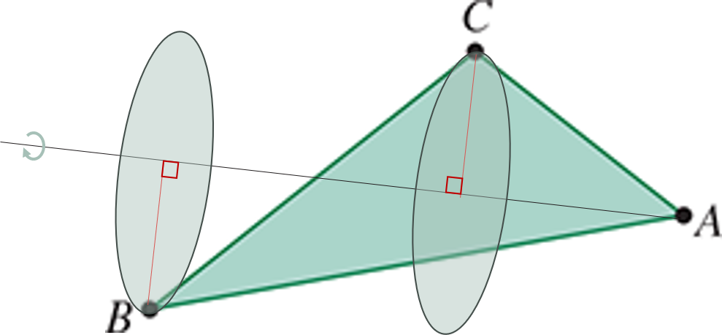
8.1 Rotational Motion and Angular Displacement (8 of 9)
CYU/TPS

Slide 10
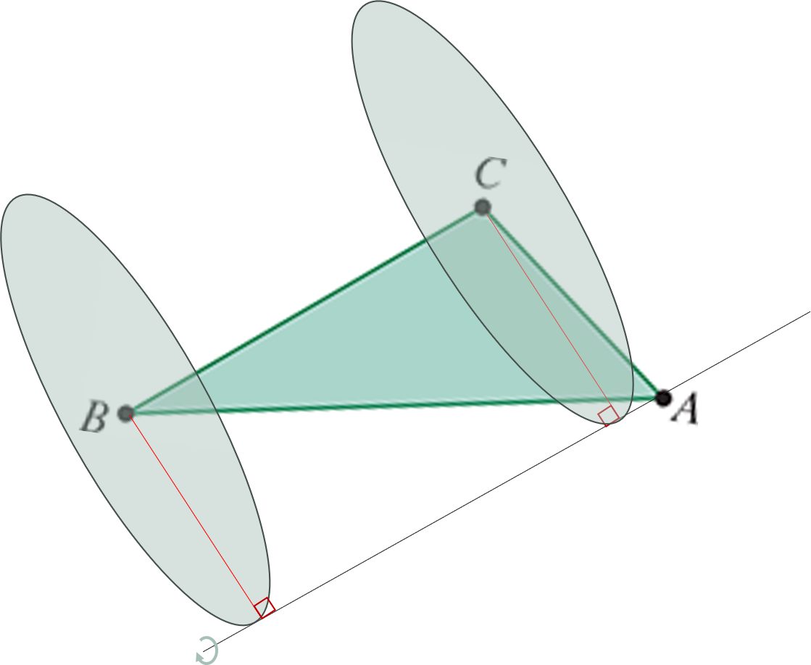
8.1 Rotational Motion and Angular Displacement (9 of 9)
CYU/TPS

Slide 11
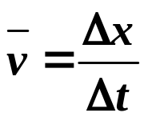
8.2 Angular Velocity and Angular Acceleration (1 of 8)
Learning Objective 8.2 – Define angular velocity and angular acceleration.
Angular Velocity
Now that we have defined angular displacement, let’s allow for this quantity to change in time.
In Chapter 02, a change in linear displacement divided by elapsed time was defined as the average linear velocity, or
Here, a change in angular velocity divided by elapsed time is defined as the average angular velocity – denoted by the Greek letter “omega”:
DEFINITION OF AVERAGE ANGULAR VELOCITY
(8.2)
SI Unit of Angular Velocity: radian per second (rad/s)

Slide 12
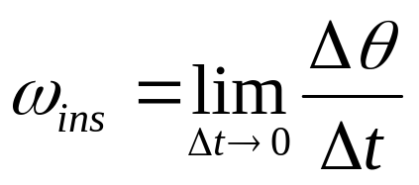
8.2 Angular Velocity and Angular Acceleration (2 of 8)
The SI unit of angular velocity is rad/s, but other units are often used, such as degrees/second or revolutions/minute (rpm).
Angular velocity, like angular displacement is also a
vector quantity
, and it
follows the same sign convention as that of angular displacement – angular velocity is positive when the rotation is counterclockwise and negative when it is clockwise.
And like we did for linear motion, where we defined the instantaneous velocity, we can also define the instantaneous angular velocity (ω_{ins}):
(8.3)

Slide 13
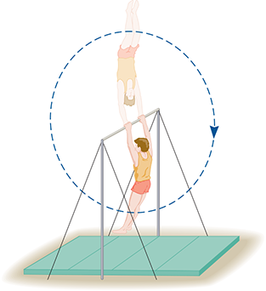
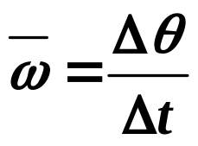
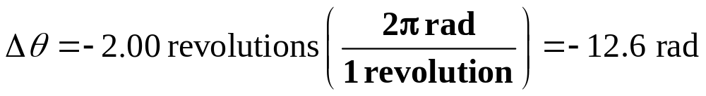
8.2 Angular Velocity and Angular Acceleration (3 of 8)
Example – Gymnast on a High Bar
A gymnast on a high bar swings through two revolutions in a time of 1.90 s, as the figure suggests. Find the average angular velocity (in rad/s) of the gymnast.
We can use Equation 8.2 to calculate the average angular velocity of the gymnast in rad/s:
To do this, we will need his angular displacement ( Δθ) in rad.
However, the problem statement tells us his displacement in revolutions, so we need to make that conversion:
The minus sign indicates his rotation direction is clockwise, as shown in the figure.

Slide 14
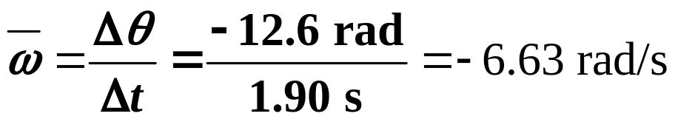
8.2 Angular Velocity and Angular Acceleration (4 of 8)
Example – Gymnast on a High Bar
We can now calculate his average angular velocity in rad/s:

Slide 15
8.2 Angular Velocity and Angular Acceleration (5 of 8)
Angular Acceleration
In Chapter 05, we studied uniform circular motion, in which an object moved along a circular path at constant angular velocity (i.e. constant ω).
Although its speed remained constant, its direction was continually changing, so the object was accelerating. We called this inward acceleration the
centripetal acceleration
.
Now we remove the requirement that the angular velocity remains constant, i.e. the object may spin faster or slower as it rotates.
A change in angular velocity gives rise to a new quantity called the
angular acceleration
.
The angular acceleration is denoted by the Greek letter “alpha” (α).
DEFINITION OF AVERAGE ANGULAR ACCELERATION
(8.4)
SI Unit of Angular Acceleration: radian per second squared (rad/s²)

Slide 16
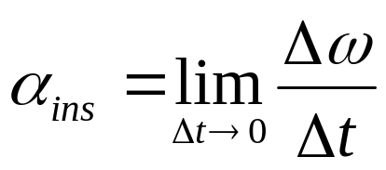
8.2 Angular Velocity and Angular Acceleration (6 of 8)
In Chapters 02 and 03, we assumed that the linear acceleration (a) was constant.
Here, we assume a similar condition and only consider motion with constant angular acceleration (α).
And like we did for linear motion, where we defined the instantaneous acceleration, we can also define the instantaneous angular acceleration (α_{ins}):

Slide 17
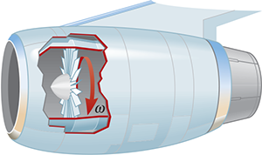
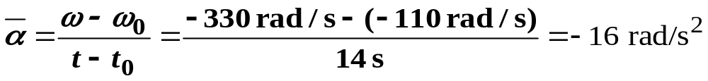
8.2 Angular Velocity and Angular Acceleration (7 of 8)
Example – A Jet Revving Its Engines
A jet awaiting clearance for takeoff is momentarily stopped on the runway. As seen from the front of one engine, the fan blades are rotating with an angular velocity of −110 rad/s, where the negative sign indicates a clockwise rotation, as in the figure. As the plane takes off, the angular velocity of the blades reaches −330 rad/s in a time of 14 s. Find the angular acceleration of the blades during this time, assuming it to be constant.
Since we know the initial and final angular velocities and the time, we can use Equation 8.4:
*The negative sign in the answer indicates that the direction of the angular acceleration is also in the
clockwise direction
.

Slide 18

8.2 Angular Velocity and Angular Acceleration (8 of 8)
CYU/TPS – An electric clock is hanging on a wall. As you are watching the second hand rotate, the clock’s battery stops functioning, and the second hand comes to a halt over a brief period of time. Which one of the following statements correctly describes the angular velocity ω and angular acceleration a of the second hand as it slows down?
ω and α are both negative.
ω is positive and α is negative.
ω is negative and α is positive.
ω and α are both positive.
Explain!

Slide 19
8.3 The Equations of Rotational Kinematics (1 of 7)
Learning Objective 8.3 – Solve rotational kinematics problems.
We now apply the vector concepts of angular displacement, angular velocity, and angular acceleration to develop a set of equations known as.
rotational kinematics
. To simplify
our analysis, we will again restrict ourselves to problems where the magnitude of the angular acceleration (a) is
constant
.
In Chapter 02 we asked the following question: An object starts from rest at t₀ = 0 s and at x₀ = 0 m and undergoes a constant acceleration a for a time t. How far does the object travel in that time?
Now we ask the same question, but in the context of rotational motion: An object starts from rest at t₀ = 0 s and at ω₀ = 0 rad/s and undergoes a constant angular acceleration a for a time t. How far (angular displacement) does the object travel in that time?

Slide 20



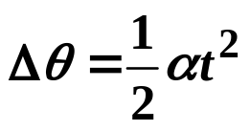
8.3 The Equations of Rotational Kinematics (2 of 7)
0
From Equation 8.2:
And...
From Equation 8.4:
0
After making theses two substitutions, we see that
.
Here is what this equation tells us: Take an object initially at rest, let it begin to rotate at a constant angular acceleration α, then Δθ is the angle it rotates through (angular displacement) in a time t.
But what if the object is already rotating, i.e. what if ω₀ ≠ 0?
Then
Δθ = ω₀t
gives us the displacement that would result if the angular acceleration
were zero, and the angular velocity remained constant at its initial value of ω₀.

Slide 21
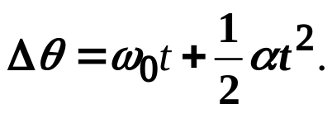
8.3 The Equations of Rotational Kinematics (3 of 7)
The total angular displacement is just the sum of these two terms:
(8.7)
We refer to Equation 8.7 as the equation for motion with constant angular acceleration.
It should look strikingly familiar, since it has the same mathematical form as the equation of motion for constant linear acceleration that we derived in Chapter 02.
This similarity reflects the close analogy between linear and rotational motion.
In fact, there is a beautiful one-to-one correspondence between the variables describing linear motion and those describing rotational motion.
The variables of linear motion have direct angular counterparts: displacement (x) is replaced by angular displacement (
ω
), velocity (v) by angular velocity (
), and acceleration
θ
α
(a) by angular acceleration (
). Swapping out for Greek letters is all that’s required!

Slide 22
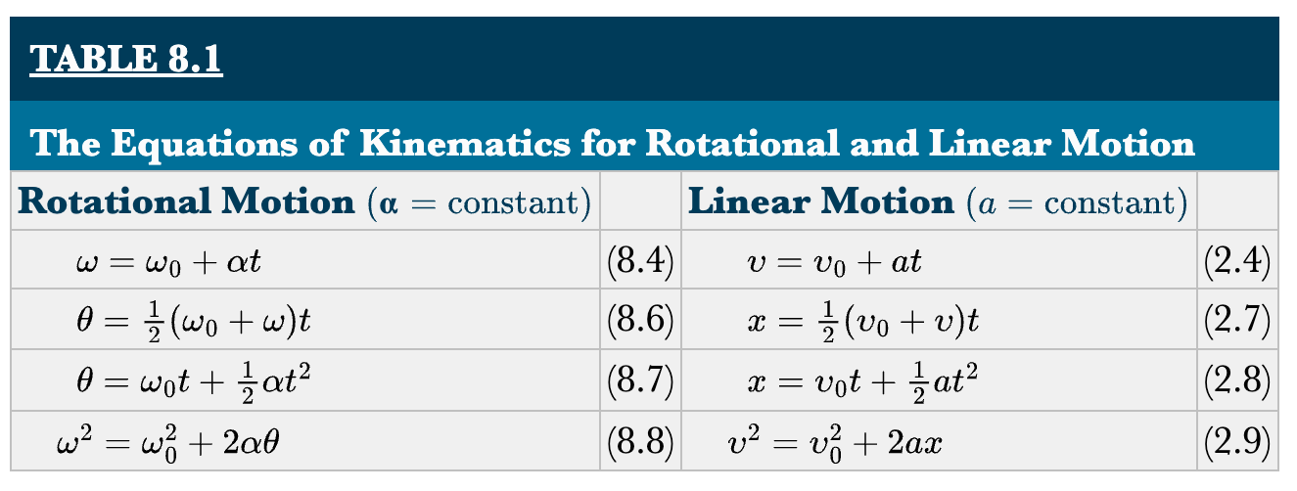
8.3 The Equations of Rotational Kinematics (4 of 7)
By making these substitutions, we obtain the complete set of equations for,
rotational kinematics
which have the same mathematical
structure as the equations for linear motion.
*The bottom equation in the left column relates the initial and final angular velocities, the angular displacement, and the angular acceleration, without the need for time.

Slide 23
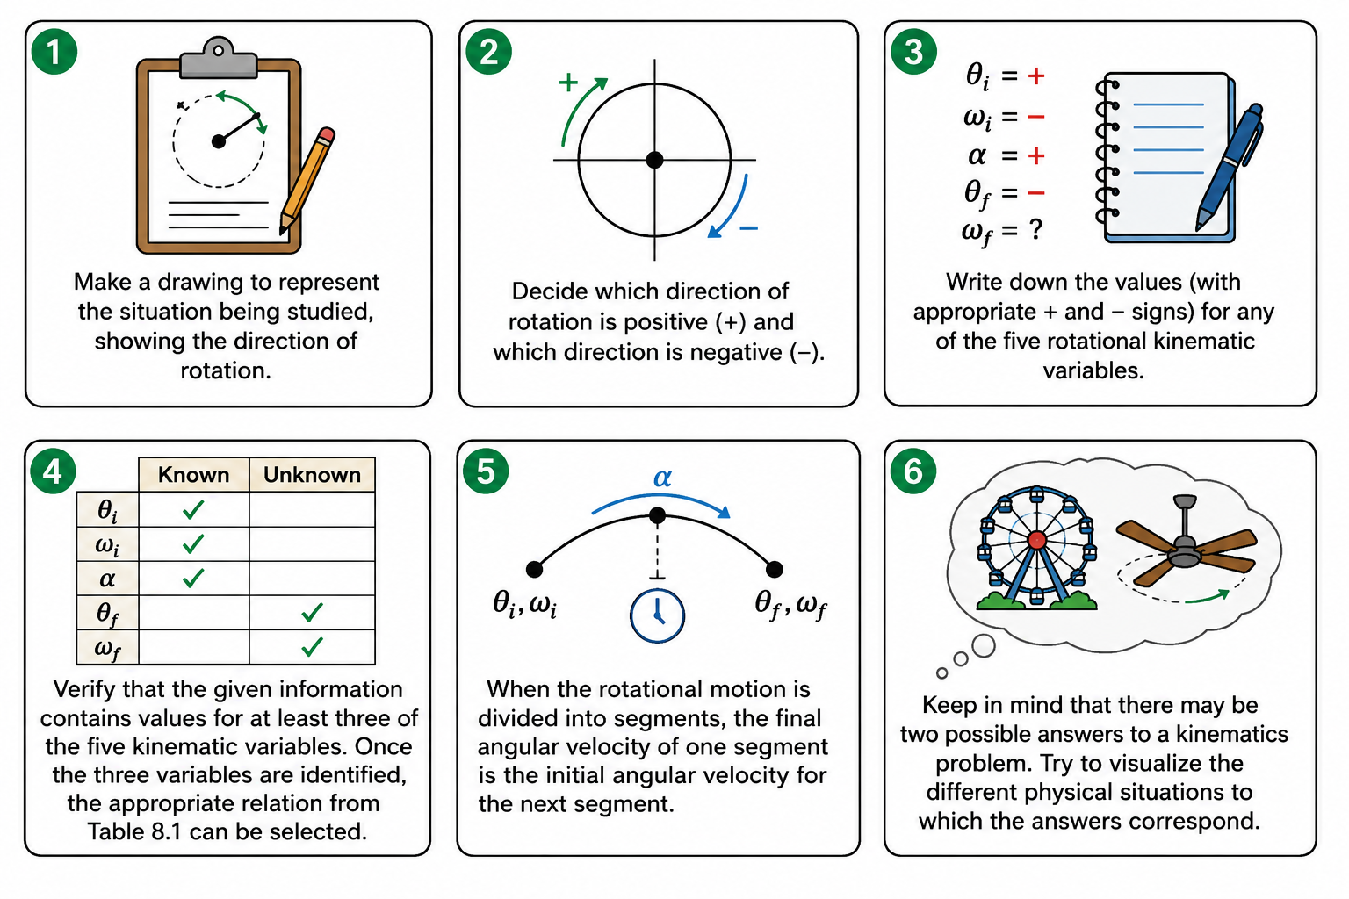

8.3 The Equations of Rotational Kinematics (5 of 7)
REASONING STRATEGY – Applying the Equations of Rotational Kinematics
Make a drawing to represent the situation being studied, showing the direction of rotation.
Decide which direction of rotation is to be called positive (+) and which direction is to be called negative (−). In this text we choose the counterclockwise direction to be positive and the clockwise direction to be negative, but this is arbitrary. But once chosen, don’t change it.
write down the values (with appropriate + and − signs) that are given for any of the five rotational kinematic variables. Be on the alert for implied data, such as the phrase “starts from rest,” which means that the value of the initial angular velocity is ω₀ = 0 rad/s . In addition, identify the variable(s) that you are being asked to determine.
Verify that the given information contains values for at least three of the five kinematic variables. Once the three variables are identified for which values are known, the appropriate relation from Table 8.1 can be selected.
When the rotational motion is divided into segments, the final angular velocity of one segment is the initial angular velocity for the next segment.
Keep in mind that there may be two possible answers to a kinematics problem. Try to visualize the different physical situations to which the answers correspond.

Slide 24
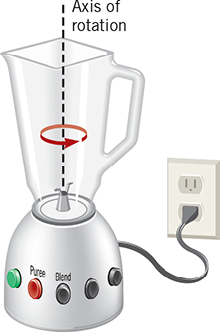
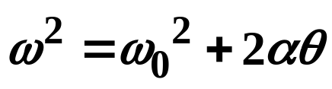
8.3 The Equations of Rotational Kinematics (6 of 7)
Example – Blending with a Blender
The blades of an electric blender are whirling with an angular velocity of +375 rad/s while the “puree” button is pushed in, as the figure shows. When the “blend” button is pressed, the blades accelerate and reach a greater angular velocity after the blades have rotated through an angular displacement of +44.0 rad. The angular acceleration has a constant value of +1740 rad/s². Find the final angular velocity of the blades.
We are looking for the final angular velocity, or ω.
We are given the following: ω₀, Δθ, and α.
We can use Equation 8.8:

Slide 25
8.3 The Equations of Rotational Kinematics (7 of 7)
CYU/TPS – The blades of a ceiling fan start from rest and, after two revolutions, have an angular speed of ω₁ rev/s. The angular acceleration of the blades is constant. What is the angular speed after eight revolutions?
ω₁ rev/s
2ω₁ rev/s
4ω₁ rev/s
8ω₁ rev/s
Discuss!

Slide 26
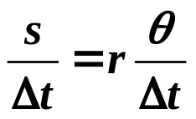

8.4 Angular Variables and Tangential Variables (1 of 6)
Learning Objective 8.4 – Relate angular and tangential variables.
Let’s revisit our rotating disc...
As the disc rotates through some angle θ, point P moves an arc length distance s, and Equation 8.1 says that
s = rθ
.
Let’s hold r constant and divide both sides of this equation by Δt:
In words, this equation is:
The left side is linear velocity (v), and the right side is r times angular velocity (ω).
Linear velocity
Angular velocity
v_{T}
The direction of the linear velocity of point P is tangent to its circular trajectory:
s
θ
P
*Note: This is the same linear velocity (v) objects had in Chapter 05, when undergoing uniform circular motion. The subscript “T” is to further clarify that the direction is tangential.
r

Slide 27
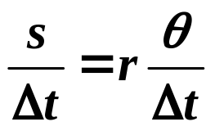
8.4 Angular Variables and Tangential Variables (2 of 6)
Thus, Equation 8.1 becomes the following:
⇒
v_{T} = rω
(8.9) (ω in rad/s)
Equation 8.9 is the relationship between linear (tangential) speed and angular speed.
Notice that the tangential speed is
directly proportional
to the radius of the circular
motion, i.e. how far the point is located from the axis of rotation.
As the object rotates, like our disc, for example, every point on the disc has the same ω, i.e. each point sweeps out the same angle in the same time.
But v_{T} varies with r.
v_{T}
v_{T}
v_{TA} = r_{A}ω
v_{TB} = r_{B}ω
v_{TC} = r_{C}ω
v_{T}
B
A
C
C
Points A, B, and C all have the same ω, but their tangential speeds are different, because their r-values are different:
r_{C}
B
r_{B}
r_{A}
A

Slide 28
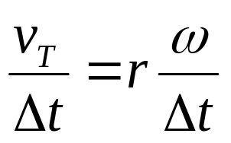
8.4 Angular Variables and Tangential Variables (3 of 6)
Now let’s divide both sides of Equation 8.9 by Δt:
a_{T}
α
The term on the left we recognize as the linear acceleration a_{T} (subscript T again, because it’s tangential).
And the term on the right is r times the angular acceleration, α.
a_{T} = rα
This is the relationship between the tangential acceleration and the angular acceleration.
Thus:
(8.10) (α in rad/s²)
Linear variable = r(Rotational variable)
*Notice that the linear variables of displacement, velocity, and acceleration are related to their rotational counterparts by a simple factor:
Displacement: s =rθ
Velocity: v_{T} =rω
.
the radius
Acceleration: a_{T} =rα

Slide 29
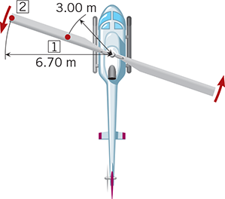
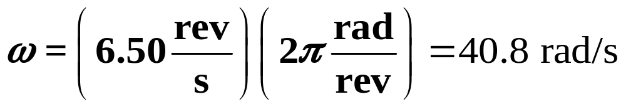
8.4 Angular Variables and Tangential Variables (4 of 6)
Example – A Helicopter Blade
A helicopter blade has an angular speed of ω = 6.50 rev/s and has an angular acceleration of α = 1.30 rev/s². For points 1 and 2 on the blade in the figure, find the magnitudes of (a) the tangential speeds and (b) the tangential accelerations.
(a) We can use Equation 8.9 to find the tangential speeds of the two points.
We will first have to convert the angular speed from rev/s to rad/s, so that our tangential speeds will have units of m/s.
Applying Equation 8.9 to each point:
Point 1:
v_{T1} = r₁ω = (3.00 m)(40.8 rad/s) = 122 m/s
Point 2:
v_{T2} = r₂ω = (6.70 m)(40.8 rad/s) = 273 m/s

Slide 30
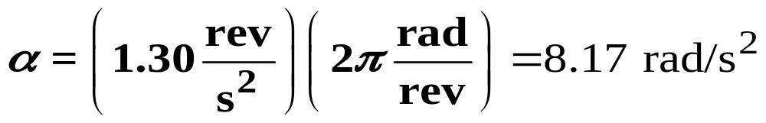
8.4 Angular Variables and Tangential Variables (5 of 6)
Example – A Helicopter Blade
A helicopter blade has an angular speed of ω = 6.50 rev/s and has an angular acceleration of α = 1.30 rev/s². For points 1 and 2 on the blade in the figure, find the magnitudes of (a) the tangential speeds and (b) the tangential accelerations.
(b) The tangential accelerations can be found with Equation 8.10, once we convert the angular acceleration from rev/s² to rad/s²:
Applying Equation 8.10 to each point:
Point 1:
a_{T1} = r₁α = (3.00 m)(8.17 rad/s²) = 24.5 m/s²
Point 2:
a_{T2} = r₂α = (6.70 m)(8.17 rad/s²) = 54.7 m/s²

Slide 31
8.4 Angular Variables and Tangential Variables (6 of 6)
CYU/TPS – A building is located on the earth’s equator. As the earth rotates about its axis, which floor of the building has the greatest tangential speed?
The first floor.
The tenth floor.
The twentieth floor.
Each floor has the same tangential speed.
Explain!

Slide 32
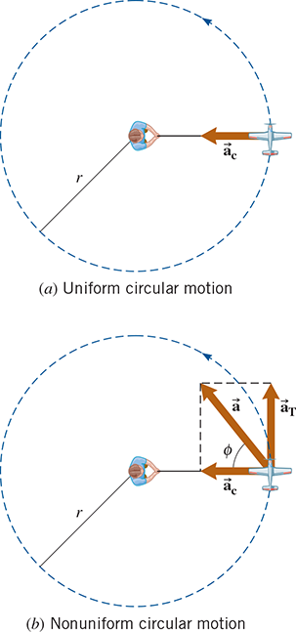
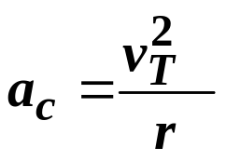

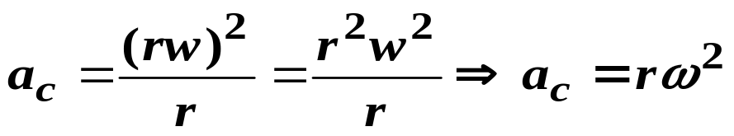
8.5 Centripetal Acceleration and Tangential Acceleration (1 of 5)
Learning Objective 8.5 – Distinguish between centripetal and tangential accelerations.
In Chapter 05, we studied uniform circular motion, where an object moved along a circular path at constant speed.
We found that, even though the speed of the object (magnitude of the tangential velocity) was constant, an acceleration was present. We called this
v_{T}
centripetal acceleration
or a_{c}.
The magnitude of a_{c} is found using Equation 5.2:
And the direction of a_{c} always points in toward the center of the circular motion.
We can write Equation 5.2 purely in terms of angular variables, since v_{T} = rω:
(ω in rad/s) (8.11)

Slide 33
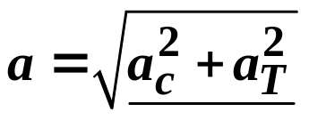
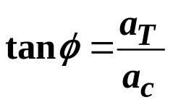
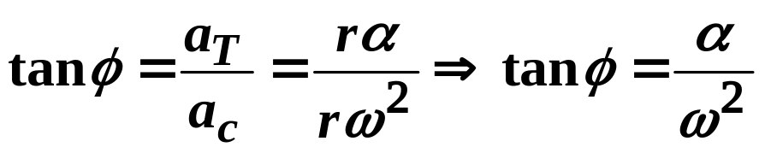
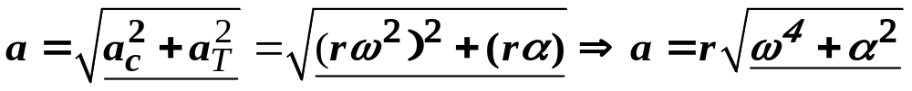
8.5 Centripetal Acceleration and Tangential Acceleration (2 of 5)
Now we want to allow for the possibility that the magnitude of v_{T} can change, i.e. the object is speeding up or slowing down...
This produces an additional component of acceleration, a_{T}.
The total acceleration will be equal to the
vector sum
of a_{T} and a_{c}, as
shown in the figure.
Since a_{T} and a_{c} are perpendicular to each other, we can find their vector sum using the Pythagorean theorem:
The angle ϕ in the figure can be determined using the tangent function:
We can write each of these equations purely in terms of angular variables:

Slide 34

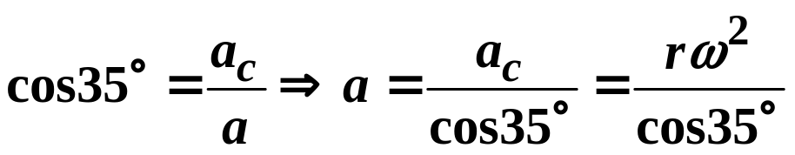
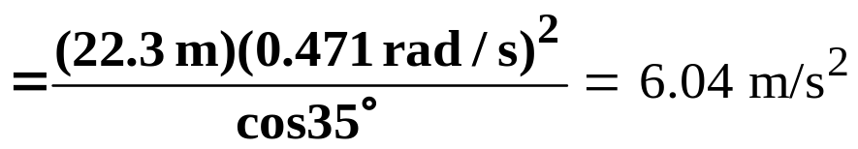
8.5 Centripetal Acceleration and Tangential Acceleration (3 of 5)
Example – A Race Car
A race car, starting from rest, travels around a circular turn of radius 22.3 m. At a certain instant, the car is still accelerating, and its angular speed is 0.471 rad/s. At this time, the total acceleration (centripetal plus tangential) makes an angle of 35.0° with respect to the radius. (a) What is the magnitude of the total acceleration? (b) What is the magnitude of the angular acceleration?
a
a_{T}
35º
a_{c}
(a) From the figure, we see that the total acceleration (a) corresponds to the hypotenuse of a right triangle containing a_{T} and a_{c}.
Let’s write a in terms of a_{c}, since we know ω:

Slide 35
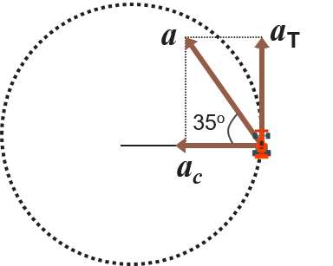
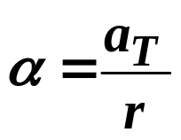
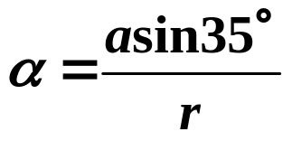
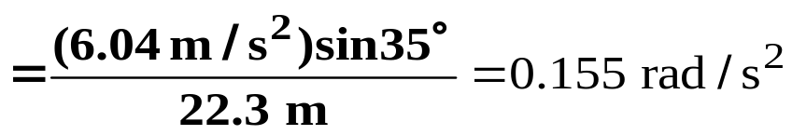
8.5 Centripetal Acceleration and Tangential Acceleration (4 of 5)
Example – A Race Car
A race car, starting from rest, travels around a circular turn of radius 22.3 m. At a certain instant, the car is still accelerating, and its angular speed is 0.471 rad/s. At this time, the total acceleration (centripetal plus tangential) makes an angle of 35.0° with respect to the radius. (a) What is the magnitude of the total acceleration? (b) What is the magnitude of the angular acceleration?
a_{T} = rα
(b) We can use Equation 8.10 to calculate the angular acceleration:
⇒
From the figure, notice that sin35° = a_{T}/a.
⇒

Slide 36
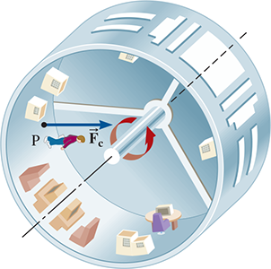
8.5 Centripetal Acceleration and Tangential Acceleration (5 of 5)
CYU/TPS – Section 5.6 discusses how the uniform circular motion of a space station can be used to create artificial gravity. This can be done by adjusting the angular speed of the space station, so the centripetal acceleration at an astronaut’s feet equals g, the magnitude of the acceleration due to the earth’s gravity. If such an adjustment is made, the acceleration at the astronaut’s head due to the artificial gravity will be...
greater than g.
equal to g.
less than g.
Explain!

Slide 37

8.6 Rolling Motion (1 of 4)
Learning Objective 8.6 – Analyze rolling motion.
One very familiar rotation is the rolling motion of a wheel.
Here, we assume that the wheel rolls along some surface without slipping.
As you drive in a car at constant speed, for example, the car moves forward, and at the same time, the wheels rotate.
We label the velocity of the car v_{cm}, since that represents the linear speed of the center of mass of the car.
Now let’s consider different points on the car’s wheels...

Slide 38
8.6 Rolling Motion (2 of 4)
If the wheel did not rotate as the car moved forward, i.e. if the wheels were “locked up” and sliding, for example, then each point on the wheel would have the same linear speed – a speed equal to the CM of the car.
This is pure
.
translational motion
Pure Translational Motion
Pure Rotational Motion
v_{cm}
Now consider if the wheel was only rotating and not moving translationally.
ω = 0
v_{cm} = rω
v_{cm}
v_{cm}
v_{cm}
ω
...And rotating with an angular velocity ω, such that v_{cm} = rω.
v_{cm}
v_{cm}
v_{cm}
This is pure
.
rotational motion
A wheel that was rolling without slipping will be the sum of these two motions...

Slide 39
8.6 Rolling Motion (3 of 4)
Pure Translational Motion
Pure Rotational Motion
Rolling Motion
v_{cm} = rω
v_{cm}
v_{cm}
2v_{cm}
ω = 0
v_{cm}
+
ω
=
ω
=
v_{cm}
v_{cm}
v_{cm}
v_{cm}
v_{cm}
v_{contact} = 0
When pure translational motion and pure rotational motion are added together, rolling motion results, and the speed of each point on the wheel will correspond to the
vector sum
of the velocities from each type of motion.
Notice that the top of the wheel moves at twice the velocity of the CM relative to the ground.
...And, the point where the wheel contacts the ground has a net velocity of 0! That means this point is instantaneously at rest with respect to the road, i.e. rolling tires (not slipping) rely on
static friction
!

Slide 40



8.6 Rolling Motion (4 of 4)
Also, because the wheel rolls without slipping, the linear distance traveled by the car, d, must equal the arc length, s, traced by a point on the edge of the wheel.
Or...
d = s
(ω in rad/s) (8.12)
Equation 8.12 shows directly that the linear speed of the car is equal to the tangential speed of a point on the edge of the wheel.
If the car has a linear acceleration parallel to the ground, then with the same reasoning as above, we can show that the linear acceleration of the car has the same magnitude as the tangential acceleration of a point on the edge of the wheel:
(α in rad/s²) (8.13)

Slide 41
8.7 The Vector Nature of Angular Variables (1 of 2)
Learning Objective 8.7 – Use the right-hand rule to determine the direction of angular vectors.
As mentioned previously, angular displacement, angular velocity, and angular acceleration are, like their linear counterparts,
.
vector quantities
We now turn our attention to determining the direction of these angular vectors.
.
To do so, we use a technique known as the
right-hand rule
RIGHT-HAND RULE
Grasp the axis of rotation with your right hand, with your fingers curling around the axis in the same sense as the rotation. Your extended thumb then points along the axis of rotation in the direction of the angular vector.

Slide 42

8.7 The Vector Nature of Angular Variables (2 of 2)
The figure to the left demonstrates how the right-hand rule would be applied to a rotating disc to determine the direction of its angular velocity vector, ω.
It is important to recognize that the direction of an angular vector does not coincide with the direction of motion of the rotating object. Instead, angular displacement, angular velocity, and angular acceleration are directed
.
along the axis of rotation

